Slide 1
Pipelining

Slide 2
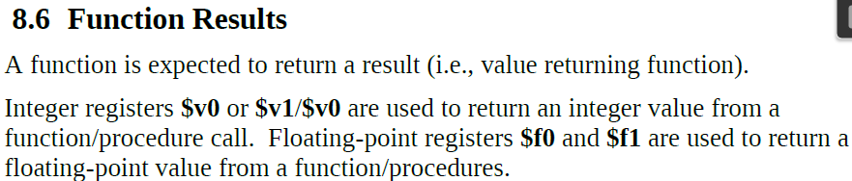
Major Corrections in Previous Lecture
While it is possible to push/pop items of various sizes (byte, halfword, etc.) it is not recommended. For such operations, it is recommended to use the entire word (4-bytes).
2.
3. In IA-32, essentially we move the return value into AX/EAX/RAX and use the ret instruction:
mov eax,5
ret

Slide 3
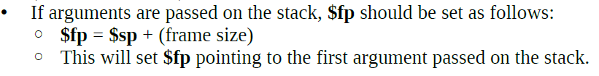
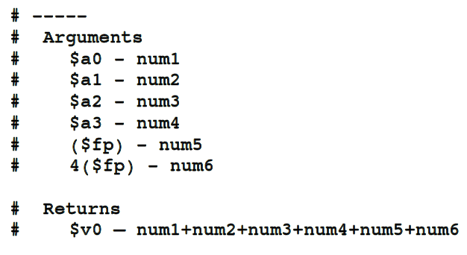
Major Corrections in Previous Lecture

Slide 4
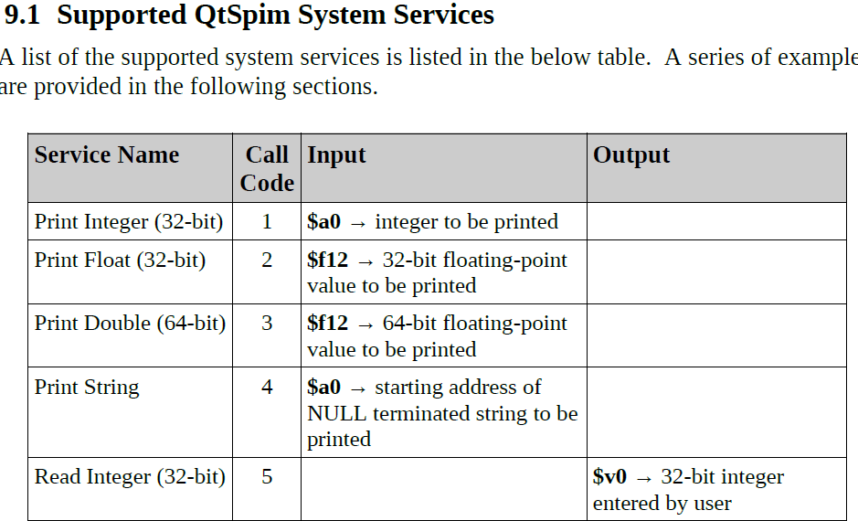

Slide 5
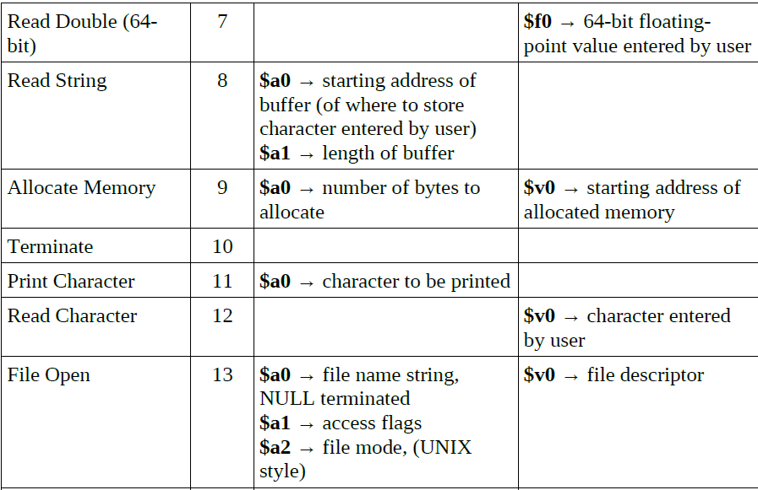

Slide 6
MIPS Instruction Types
Arithmetic & Logical - manipulate data in registers add $s1, $s2, $s3 $s1 = $s2 + $s3 or $s3, $s4, $s5 $s3 = $s4 OR $s5
Data Transfer - move register data to/from memory lw $s1, 100($s2) $s1 = Memory[$s2 + 100] sw $s1, 100($s2) Memory[$s2 + 100] = $s1
Branch - alter program flow beq $s1, $s2, 25 if ($s1==$s1) PC = PC + 4 + 4*25

Slide 7
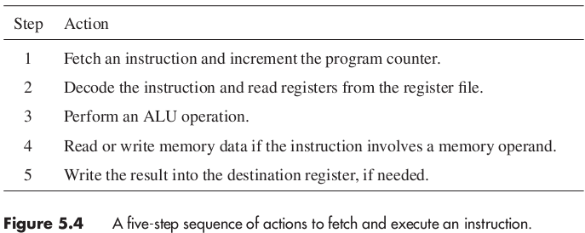
5 Step suitable for all RISC Instructions

Slide 8
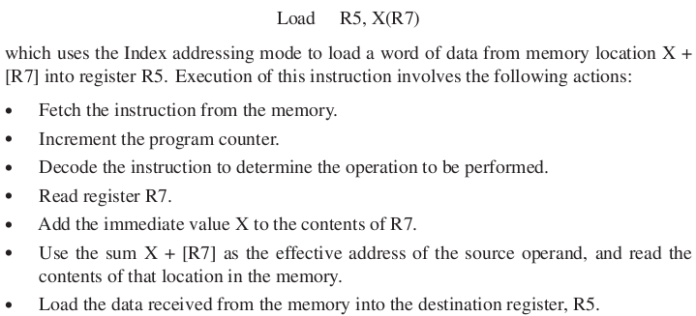
Load Instructions (1)

Slide 9
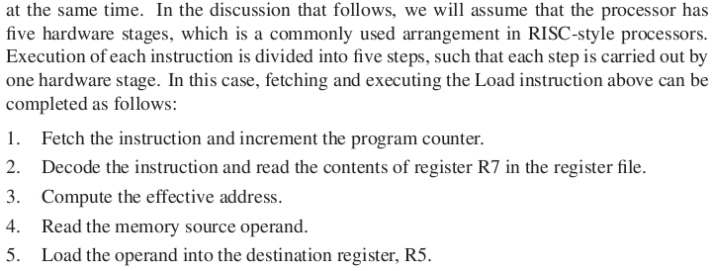
Load Instructions (2)

Slide 10
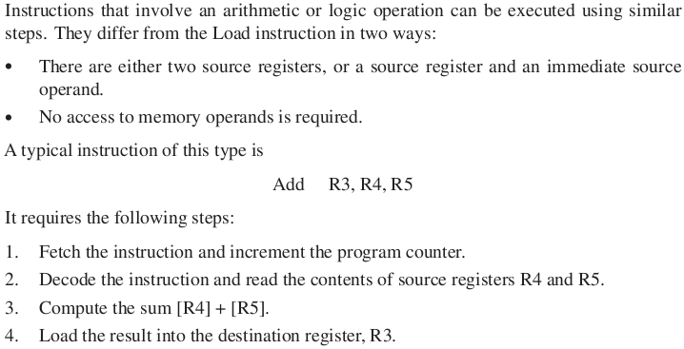

Arithmetic & Logic Instructions (1)
Notes:
Load the result into the des

Slide 11
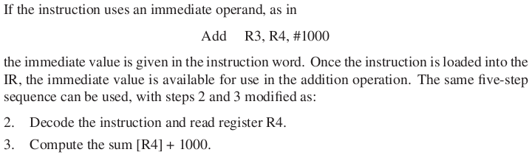
Arithmetic & Logic Instructions (2)
:

Slide 12
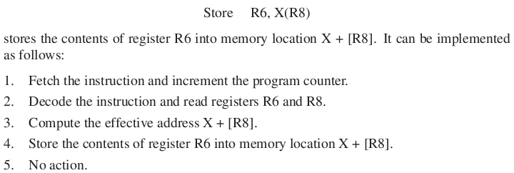
Store Instructions (1)

Slide 13
Making the Execution of Programs Faster
Use faster circuit technology to build the processor and the main memory.
Arrange the hardware so that more than one operation can be performed at the same time.
In the latter way, the number of operations performed per second is increased even though the elapsed time needed to perform any one operation is not changed.

Slide 14
Traditional Pipeline Concept
Laundry Example
Ann, Brian, Cathy, Dave each have one load of clothes to wash, dry, and fold
Washer takes 30 minutes
Dryer takes 40 minutes
“Folder” takes 20 minutes
A
B
C
D

Slide 15
Traditional Pipeline Concept
6 PM
7
8
9
10
11
Midnight
Time
30
40
20
30
40
20
30
40
20
30
40
20
Sequential laundry takes 6 hours for 4 loads
If they learned pipelining, how long would laundry take?
A
B
C
D

Slide 16
Traditional Pipeline Concept
6 PM
7
8
9
10
11
Midnight
T
a
s
k
O
r
d
e
r
Time
30
40
40
40
40
20
A
Pipelined laundry takes 3.5 hours for 4 loads
B
C
D

Slide 17
Traditional Pipeline Concept
6 PM
7
8
9
Pipelining doesn’t help latency of single task, it helps throughput of entire workload
Pipeline rate limited by slowest pipeline stage
Multiple tasks operating simultaneously using different resources
Potential speedup = Number pipe stages
Unbalanced lengths of pipe stages reduces speedup
Time to “fill” pipeline and time to “drain” it reduces speedup
Stall for Dependences
Time
T
a
s
k
O
r
d
e
r
30
40
40
40
40
20
A
B
C
D

Slide 18
Pipeline Hazards
Where one instruction cannot immediately follow another
Types of hazards
Structural hazards - attempt to use the same resource by two or more instructions
Control hazards - attempt to make branching decisions before branch condition is evaluated
Data hazards - attempt to use data before it is ready
Can always resolve hazards by waiting

Slide 19
Structural Hazards
Attempt to use the same resource by two or more instructions at the same time
Example: Single Memory for instructions and data
Accessed by IF stage
Accessed at same time by MEM stage
Solutions
Delay the second access by one clock cycle, OR
Provide separate memories for instructions & data
This is called a “Harvard Architecture”
Real pipelined processors have separate caches

Slide 20
Pipelined Example - Executing Multiple Instructions
Consider the following instruction sequence:
lw $r0, 10($r1)
sw $sr3, 20($r4)
add $r5, $r6, $r7
sub $r8, $r9, $r10

Slide 21
Alternative View - Multicycle Diagram

Slide 22
Alternative View - Multicycle Diagram
Memory Conflict

Slide 23
One Memory Port Structural Hazards
Time (clock cycles)
Cycle 1
Cycle 2
Cycle 3
Cycle 4
Cycle 5
Cycle 6
Cycle 7
I
n
s
t
r.
O
r
d
e
r
Load
Ifetch
Reg
ALU
DMem
Reg
Instr 1
Ifetch
Reg
ALU
DMem
Reg
Instr 2
Ifetch
Reg
ALU
DMem
Reg
Stall
Bubble
Bubble
Bubble
Bubble
Bubble
Instr 3
Ifetch
Reg
ALU
DMem
Reg

Slide 24
Data Hazards
Data hazards occur when data is used before it is ready
The use of the result of the SUB instruction in the next three instructions causes a data hazard, since the register $2 is not written until after those instructions read it.

Slide 25
Data Hazards
Read After Write (RAW)
Instr_{J} tries to read operand before Instr_{I} writes it
Caused by a “Dependence” (in compiler nomenclature). This hazard results from an actual need for communication.
Execution Order is:
Instr_{I}
Instr_{J}
I: add r1,r2,r3
J: sub r4,r1,r3

Slide 26
Data Hazards
Write After Read (WAR)
Instr_{J} tries to write operand before Instr_{I} reads i
Gets wrong operand
Called an “anti-dependence” by compiler writers. This results from reuse of the name “r1”.
Can’t happen in MIPS 5 stage pipeline because:
All instructions take 5 stages, and
Reads are always in stage 2, and
Writes are always in stage 5
Execution Order is:
Instr_{I}
Instr_{J}
I: sub r4,r1,r3
J: add r1,r2,r3
K: mul r6,r1,r7

Slide 27
Data Hazards
Write After Write (WAW)
Instr_{J} tries to write operand before Instr_{I} writes it
Leaves wrong result ( Instr_{I} not Instr_{J} )
Called an “output dependence” by compiler writers This also results from the reuse of name “r1”.
Can’t happen in MIPS 5 stage pipeline because:
All instructions take 5 stages, and
Writes are always in stage 5
Execution Order is:
Instr_{I}
Instr_{J}
I: sub r1,r4,r3
J: add r1,r2,r3
K: mul r6,r1,r7

Slide 28
Data Hazard Detection in MIPS (1)
Read after Write
IF/ID
ID/EX
EX/MEM
MEM/WB
1a: EX/MEM.RegisterRd = ID/EX.RegisterRs
1b: EX/MEM.RegisterRd = ID/EX.RegisterRt
2a: MEM/WB.RegisterRd = ID/EX.RegisterRs
2b: MEM/WB.RegisterRd = ID/EX.RegisterRt
EX hazard
MEM hazard

Slide 29
Data Hazards
Solutions for Data Hazards
Stalling
Forwarding:
connect new value directly to next stage
Reordering

Slide 30
Data Hazard - Stalling

Slide 31
Data Hazards - Stalling
Simple Solution to RAW
Hardware detects RAW and stalls
Assumes register written then read each cycle
+ low cost to implement, simple
-- reduces IPC
Try to minimize stalls
Minimizing RAW stalls
Bypass/forward/short­circuit (We will use the word “forward”)
Use data before it is in the register
+ reduces/avoids stalls
-- complex
Crucial for common RAW hazards

Slide 32
Data Hazards - Forwarding
Key idea: connect new value directly to next stage
Still read s0, but ignore in favor of new result
Problem: what about load instructions?

Slide 33
Data Hazards - Forwarding
STALL still required for load - data avail. after MEM
MIPS architecture calls this delayed load, initial implementations required compiler to deal with this

Slide 34
Data Hazards
This is another representation of the stall.
LW R1, 0(R2) | IF | ID | EX | MEM | WB
SUB R4, R1, R5 |  | IF | ID | EX | MEM | WB
AND R6, R1, R7 |  |  | IF | ID | EX | MEM | WB
OR R8, R1, R9 |  |  |  | IF | ID | EX | MEM | WB
LW R1, 0(R2) | IF | ID | EX | MEM | WB
SUB R4, R1, R5 |  | IF | ID | stall | EX | MEM | WB
AND R6, R1, R7 |  |  | IF | stall | ID | EX | MEM | WB
OR R8, R1, R9 |  |  |  | stall | IF | ID | EX | MEM | WB

Slide 35
Forwarding
Key idea: connect data internally before it's stored
IF/ID
ID/EX
EX/MEM
MEM/WB
How would you design the forwarding?

Slide 36
Data Hazard Solution: Forwarding
Key idea: connect data internally before it's stored
Assumption:
The register file forwards values that are read and written during the same cycle.

Slide 37
Data Hazard Summary
Three types of data hazards
RAW (MIPS)
WAW (not in MIPS)
WAR (not in MIPS)
Solution to RAW in MIPS
Stall
Forwarding
Detection & Control
EX hazard
MEM hazard
A stall is needed if read a register after a load instruction that writes the same register.
Reordering

Slide 38
Data Hazards
Solutions for Data Hazards
Stalling
Forwarding:
connect new value directly to next stage
Reordering

Slide 39
Data Hazard - Stalling

Slide 40
Data Hazard Solution: Forwarding
Key idea: connect data internally before it's stored
Assumption:
The register file forwards values that are read and written during the same cycle.

Slide 41
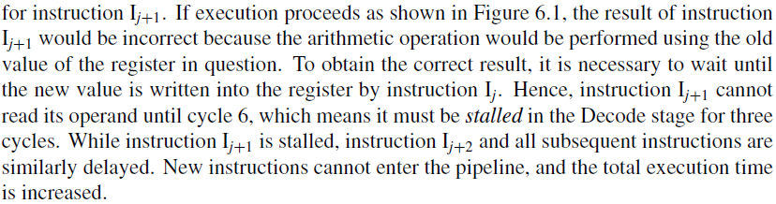
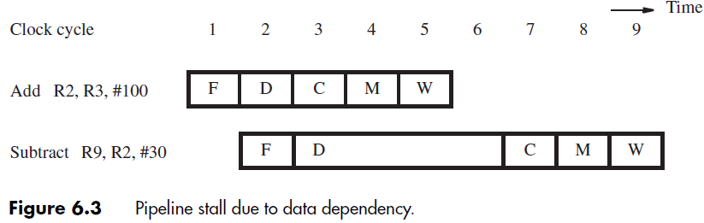
Pipeline stall due to Data Dependency

Slide 42
Pipeline stall due to Data Dependency

Slide 43
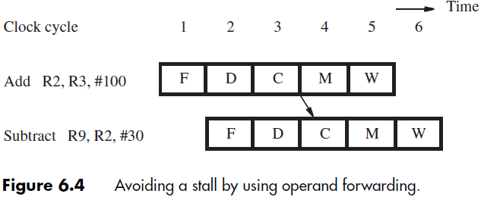
Avoiding Pipeline stalls (1)

Slide 44
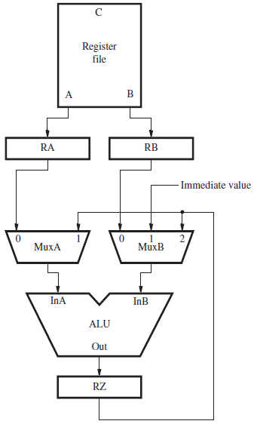
Avoiding Pipeline stalls (2)

Slide 45
Control Hazards
A control hazard is when we need to find the destination of a branch, and can’t fetch any new instructions until we know that destination.
A branch is either
Taken: PC <= PC + 4 + Immediate
Not Taken: PC <= PC + 4

Slide 46
Control Hazard on Branches Three Stage Stall
Control Hazards
10: beq r1,r3,36
Ifetch
Reg
ALU
DMem
Reg
14: and r2,r3,r5
Ifetch
Reg
ALU
DMem
Reg
18: or r6,r1,r7
Ifetch
Reg
ALU
DMem
Reg
22: add r8,r1,r9
Ifetch
Reg
ALU
DMem
Reg
36: xor r10,r1,r11
Ifetch
Reg
ALU
DMem
Reg
The penalty when branch take is 3 cycles!

Slide 47
Branch Hazards
Just stalling for each branch is not practical
Common assumption: branch not taken
When assumption fails: flush three instructions
(Fig. 6.37)

Slide 48
Control Hazard Solutions
Stall
stop loading instructions until result is available
Predict
assume an outcome and continue fetching (undo if prediction is wrong)
lose cycles only on mis-prediction
Delayed branch
specify in architecture that the instruction immediately following branch is always executed

